Slide 1

WAY TO ENTERPRISE
AWS
VTI ACADEMY
Author: duy.nguyenngoc1@vti.com.vn

Slide 2
On-premise strategy with AWS
FSx Service
Storage Gateway Service
DataSync Service
Transfer Family Service
Snow Family Service
VM Import/Export (Old)
Migration Hub
  Server Migration Service
  Data Migration Service
  Application Discovery Service

Slide 3
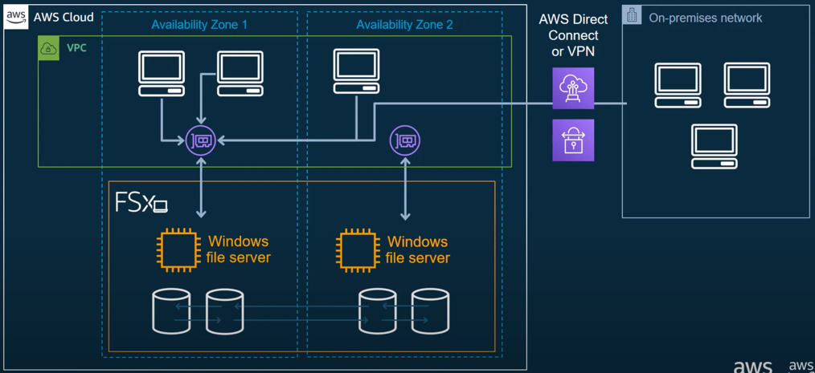
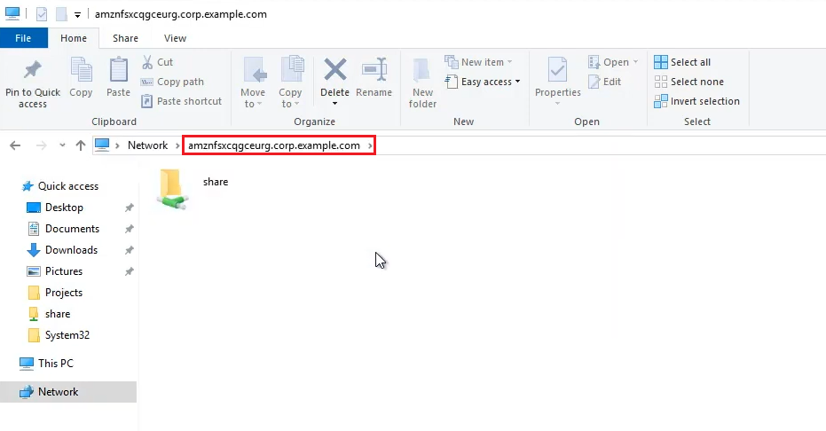
FSX Service
FSx for Windows File Server
FSx for Lustre

Slide 4
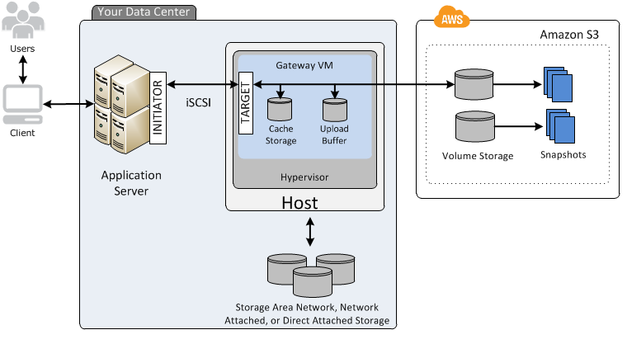
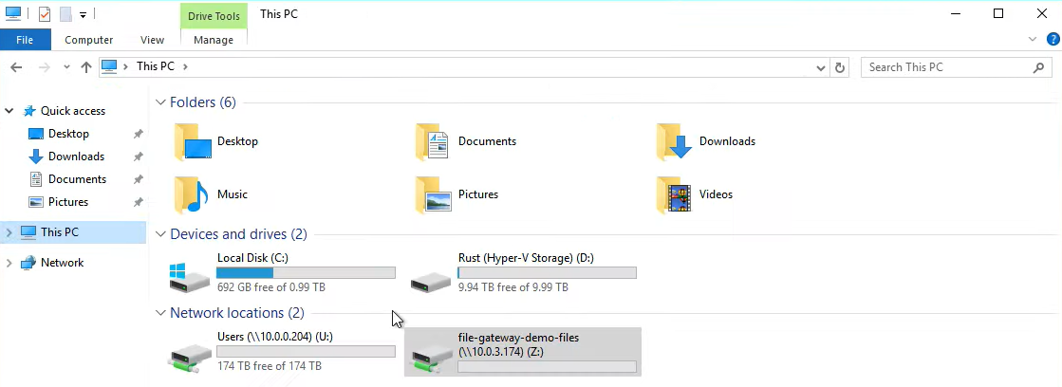
Storage Gateway Service
File Gateway
Volume Gateway
Tape Gateway
FSx File Gateway

Slide 5
DataSync Service
An online data transfer service that helps transfer large amounts of data quickly from on-premises storage to AWS storage or between AWS storages together
Copy large datasets with millions of files, without having to build custom solutions with open source tools, or license and manage expensive software, …
High-performance, secure data transfer
Usecases
  Transfer large amount of data from on-premises (VMware, KVM, Hyper-V), EC2 instance to AWS
  Transfer data between AWS Storage Services (Ex: EFS 🡺 S3 Glacier)
Price: https://aws.amazon.com/datasync/pricing
Tutorial: https://docs.aws.amazon.com/datasync/latest/userguide/what-is-datasync.html

Slide 6
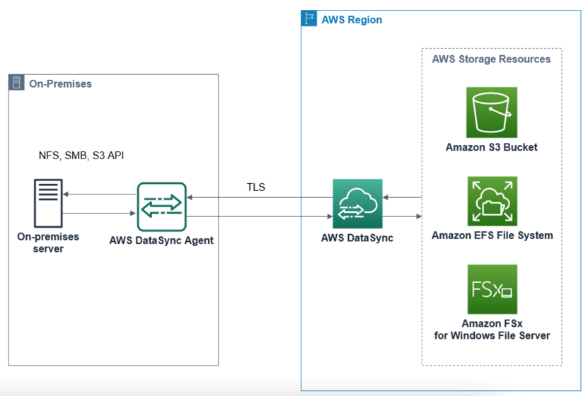
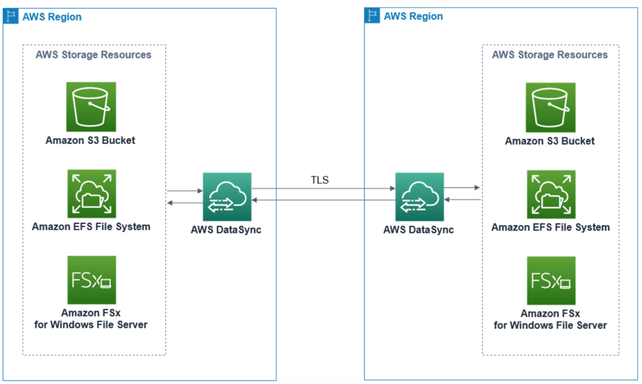
DataSync Service
Flow
  Data go through the internet (On-premises server 🡺 AWS)
  Data go through VPC Endpoint Private Link (Service AWS 🡺 Service AWS)
Data transfer between storage on-premises and AWS
Data transfer between AWS storage services

Slide 7
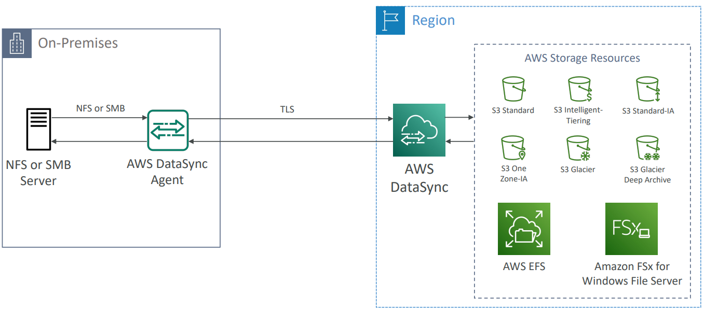
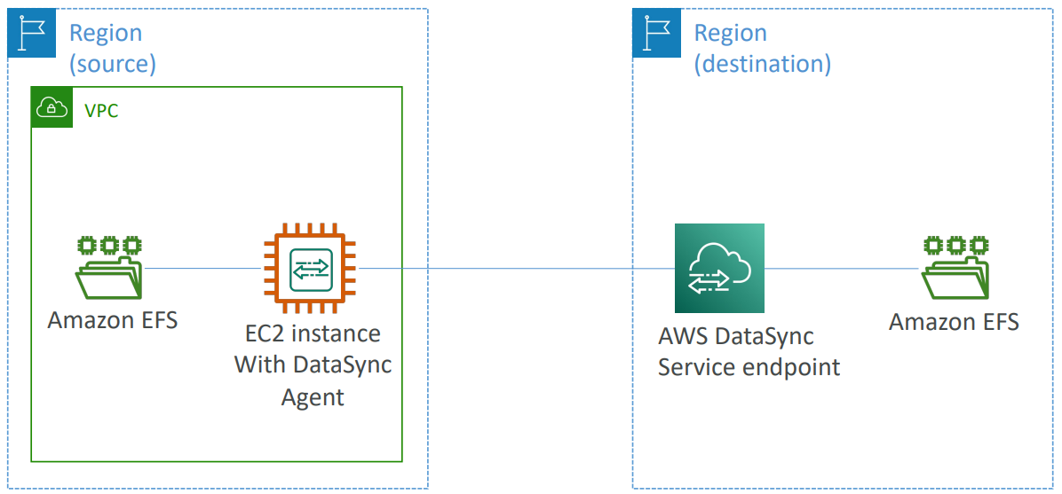
DataSync Service
Can transfer data to
  EFS
  FSx
  S3
  Network File System (NFS)
  Server Message Block (SMB)
  …
Replication tasks can be scheduled hourly, daily, weekly
Data transfer between storage on-premises and AWS
EFS 🡺 other EFS

Slide 8
DataSync Service
Demo
  https://www.youtube.com/watch?v=_qhTF-gB-JE

Slide 9
Transfer Family Service
A fully-managed service for file transfers into and out of S3 or EFS using the FTP protocol
Support transferring data over the following protocols
  Secure Shell (SSH) File Transfer Protocol (SFTP)
  File Transfer Protocol Secure (FTPS)
  File Transfer Protocol (FTP)
Price: https://aws.amazon.com/aws-transfer-family/pricing
Tutorial: https://docs.aws.amazon.com/transfer/latest/userguide/what-is-aws-transfer-family.html

Slide 10
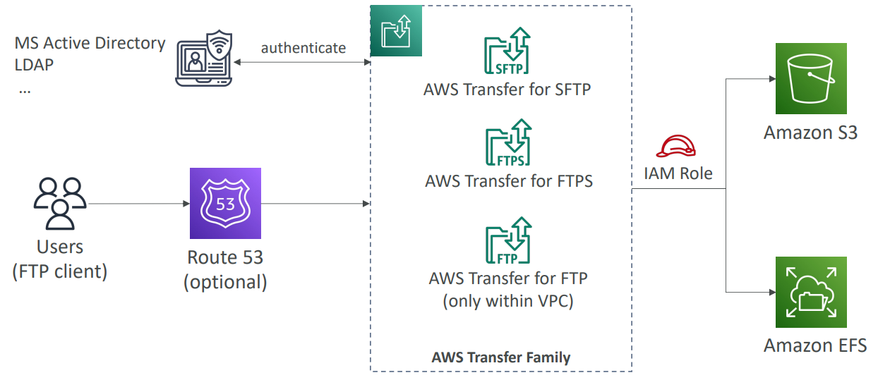
Transfer Family Service
Usecases
  Data lakes in AWS for uploads from third parties such as vendors and partners
  Internal transfers within your organization

Slide 11
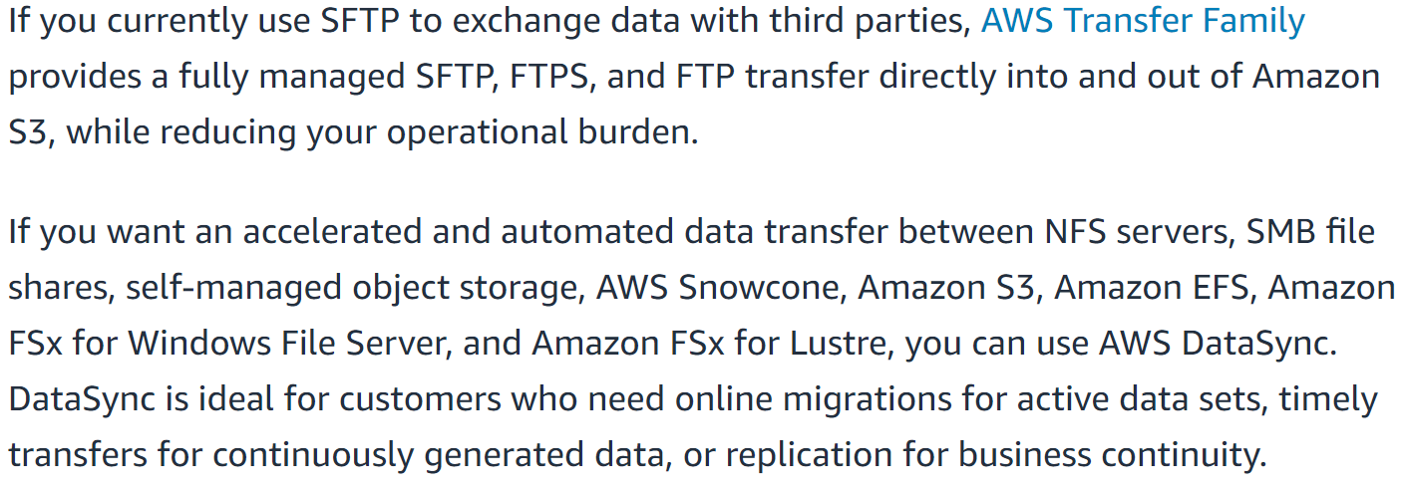
Transfer Family Service
Choose Datasync or Transfer Family
https://stackoverflow.com/questions/69860667/aws-datasync-vs-aws-transfer-family

Slide 12
Transfer Family Service
Demo
  https://www.youtube.com/watch?v=AQtTG2N_QCg

Slide 13
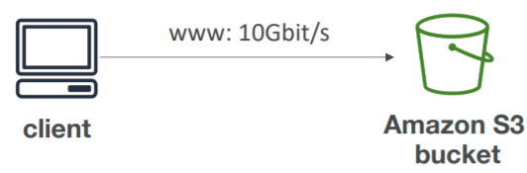
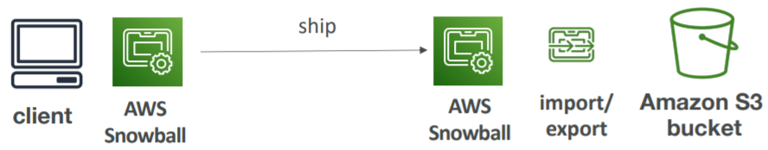
Snow Family Service
Direct upload to S3
Snow Family

Slide 14
Summary
FSx Service
  Is cloud drive, you can access & use drive on on-premises via Map Network Drive
  2 types: FSx for Windows File Server, FSx for Lustre
  Migrate existing file data into FSx 🡺 Using DataSync
Storage Gateway Service
  Is hybrid unlimited cloud storage, you can access & use drive on on-premises via virtual drive
  Low-latency performance by caching frequently accessed data on premises
  Types: File Gateway, Volume Gateway, Tape Gateway, FSx File Gateway

Slide 15
Summary
DataSync Service
  Transfer large amounts of data quickly from on-premises to AWS or between AWS storages together
  Migrate data via the internet or Private Link
Transfer Family Service
  Transfers data into and out of S3, EFS using the FTP protocol
  Similar to DataSync

Slide 16
Summary
Snow Family Service
  Transfer large amount of data (several TBs, PBs) between on-premises and S3 via physical devices sent to AWS (Not go throught internet)

Slide 17
Q & A
Copyright © VTI Academy All Rights Reserved

